Slide 1


Well-Posed Problems in Machine Learning
This presentation explores the importance of well-posed problems in machine learning, examining their characteristics, types, and real-world applications.
by pavan sai

Slide 2
Introduction to Well-Posed Problems
Definition
Key Factors
A well-posed problem in machine learning is one that has a unique and stable solution.
The solution is both achievable and reliable, ensuring accurate and consistent results.

Slide 3
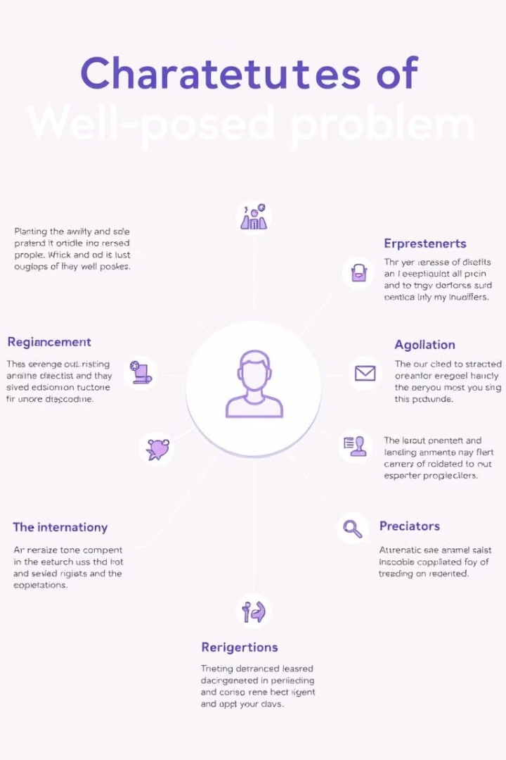
Characteristics of Well-Posed Problems
Existence
Uniqueness
A solution to the problem must exist.
The solution must be unique, avoiding multiple possible outcomes.
Stability
Small changes in the input should not drastically alter the solution.

Slide 4
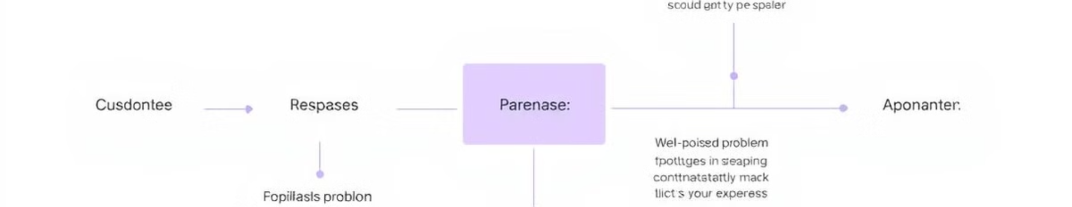
Types of Well-Posed Problems
Classification
Regression
Clustering
Categorizing data into predefined classes, such as image recognition or spam detection.
Predicting continuous values, like predicting stock prices or housing prices.
Grouping data points based on similarities, such as customer segmentation or document clustering.

Slide 5
Ill-Posed Problems vs. Well-Posed Problems
Well-Posed
Ill-Posed
Unique, stable solutions.
Multiple, unstable, or no solutions.

Slide 6




Importance of Well-Posed Problems in Machine Learning
Accuracy
Stability
Generalization
Well-posed problems ensure accurate predictions and reliable outcomes.
Solutions remain consistent even with minor variations in input data.
Models trained on well-posed problems generalize well to new, unseen data.

Slide 7

Examples of Well-Posed Problems in Machine Learning
1
Image Classification
Identifying objects in images, like classifying different types of animals.
2
Natural Language Processing
Understanding and generating human language, like translating text or summarizing documents.
3
Fraud Detection
Identifying fraudulent transactions based on patterns and anomalies in financial data.

Slide 8




Techniques for Addressing Ill-Posed Problems
Regularization
Adding constraints to the learning process to improve stability and prevent overfitting.
Data Augmentation
Generating synthetic data to increase the size and diversity of the training dataset.
Dimensionality Reduction
Simplifying the problem by reducing the number of features or variables.

Slide 9



Challenges in Defining Well-Posed Problems
1
Complexity
2
Data Bias
3
Subjectivity

Slide 10

Conclusion and Future Directions
Well-posed problems are essential for reliable and accurate machine learning solutions. Further research is needed to better understand and address challenges related to defining and solving complex, ill-posed problems.

